Slide 1
CORONAVIRUS PANDEMIC ( COVID -19 )

Slide 2
Roadmap
BACKGROUND
OBJECTIVE
CHALLENGES WITH DATASET
1
3
5
2
4
6
MOTIVATION
ANALYSIS QUESTION
DATASET DESCRIPTION

Slide 3
Roadmap
DATA ANALYSIS
SWOT ANALYSIS
SUMMARY
7
9
11
8
10
12
IMPACT
RECOMMENDATION
REFRENCES

Slide 4

Background
The new coronavirus SARS-CoV-2 is responsible for COVID-19, commonly known as the coronavirus disease, which is a highly contagious respiratory illness. In December 2019, the first case was reported and was spread worldwide after that causing pandemic. The effects of covid varied from people to people and for every age group.

Slide 5
Motivation
Studying the different aspect of covid.
To gain insight of how covid affected countries and continents.
By analysing the data, we can understand different aspects of the data sets ,like which is the place where the covid is most effected , which is the place where people are vaccinated etc.

Slide 6
Objective
We may learn more about the worldwide implications, trends, and patterns of the pandemic by analysing the COVID-19 data collection.
Identify the COVID-19 risk factors, such as age, underlying medical problems, and vaccination history, are the most important ones.

Slide 7
Objective
Examine the different trends and patterns for the given data by visualizing on the bases of years, quarters, months and days.
Analyse the data according to the different types like vaccinated, total cases, hospitalizations etc.

Slide 8
Analysis Questions
Analyze the key parameter index of all important aspects.
What is the dispersion of COVID-19 cases among various continents and countries?
How does the stringency index for COVID-19 prevention measures vary across different continents?
Comparison between total cases and total deaths.
Who was affect more male smoker or female smokers?

Slide 9
Analysis Questions
How many deaths occurred in patients with pre-existing health conditions or habits such as diabetes, smoking?
Comparison of people taken one dose of vaccine with fully vaccinated people.
Detail about people admitted in ICU in different continents.
Difference between people booster dose in 2021 and 2022.

Slide 10
Challenges with Dataset
There was some information on country column which was false so cleaning the data from python.

Slide 11
Dataset Description
About 157K covid records.
Covering 6 continents and 227 countries.
The data was gathered from a variety of sources, including the World Health Organization (WHO), the European Centre for Disease Prevention and Control (ECDC), and specific country government websites.

Slide 12
DATA ANALYSIS

Slide 13
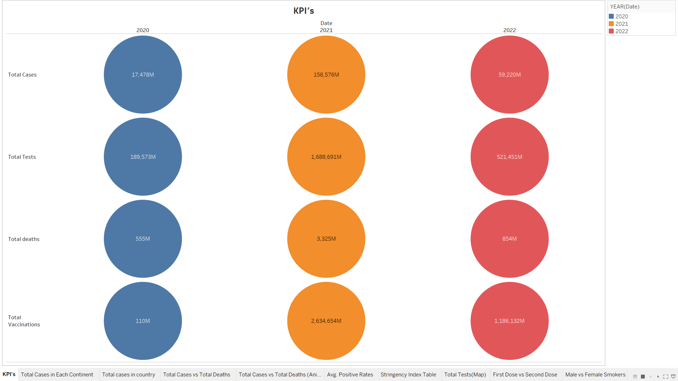
Circle Chart: Analyze the key parameter index of all important aspects
Key parameter index , this graphs shows us how 2021 was the most affected year .

Slide 14
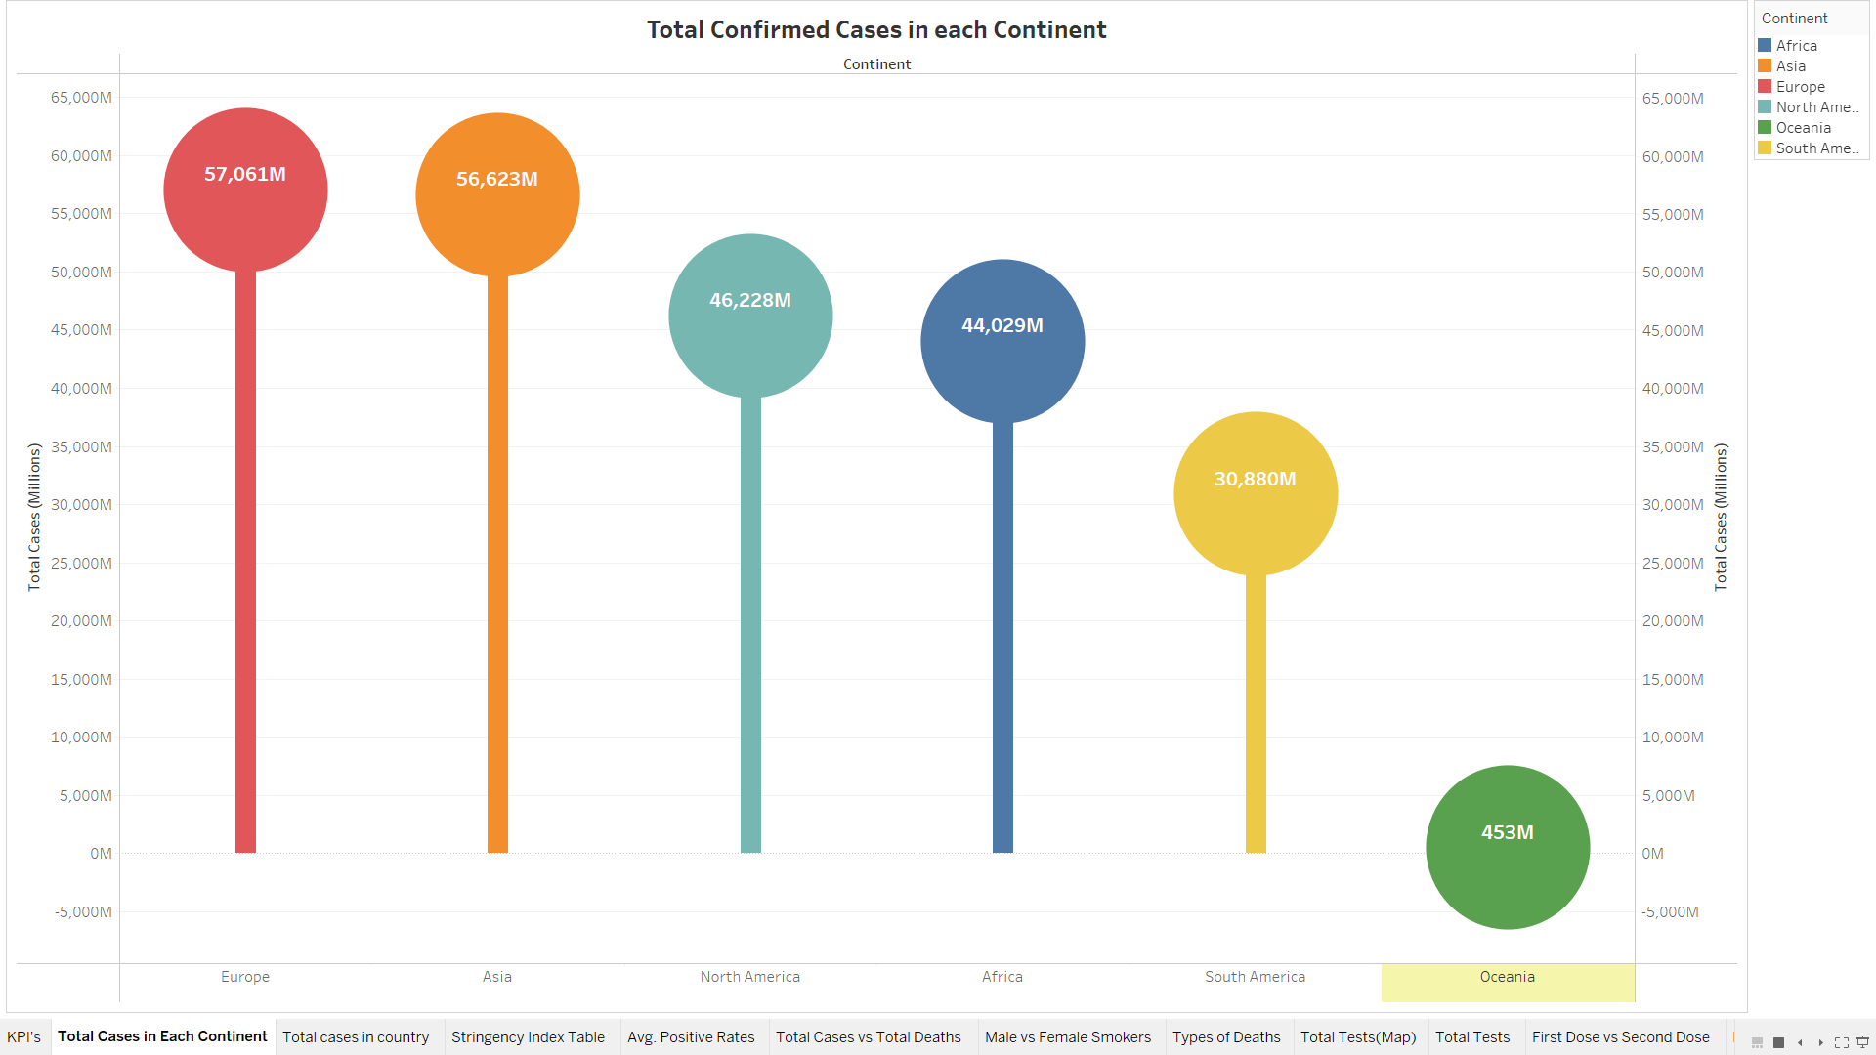
The Dispersion of COVID-19 cases among various continents and countries
This chart tells us the total number of confirmed cases in different continents . Europe hit hard by covid-19.

Slide 15
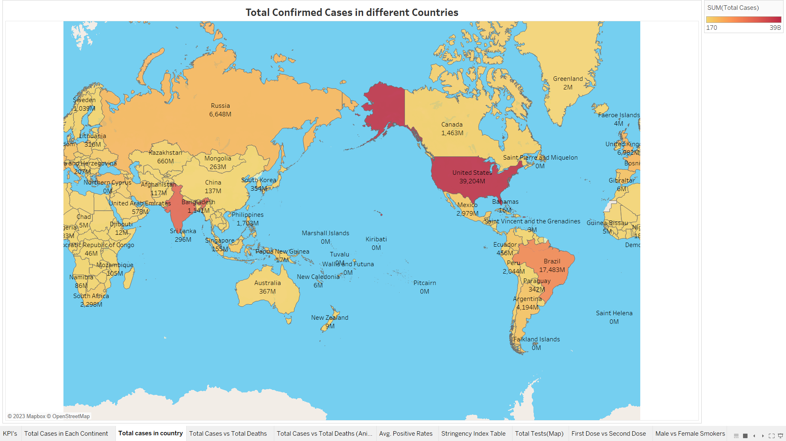
Maps
The map shows us total confirmed cases in different countries.

Slide 16
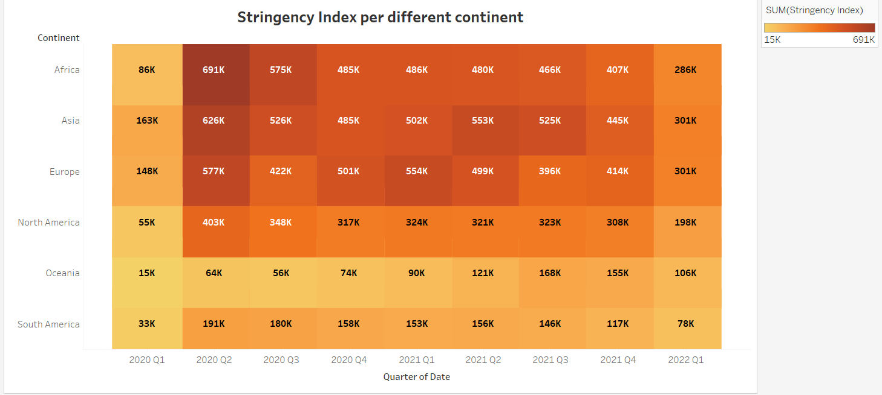
Heat Maps
Stringency index for different continents and at top is Africa in its 2nd quarter and least is of Oceania with 15k in its 1st quarter.

Slide 17
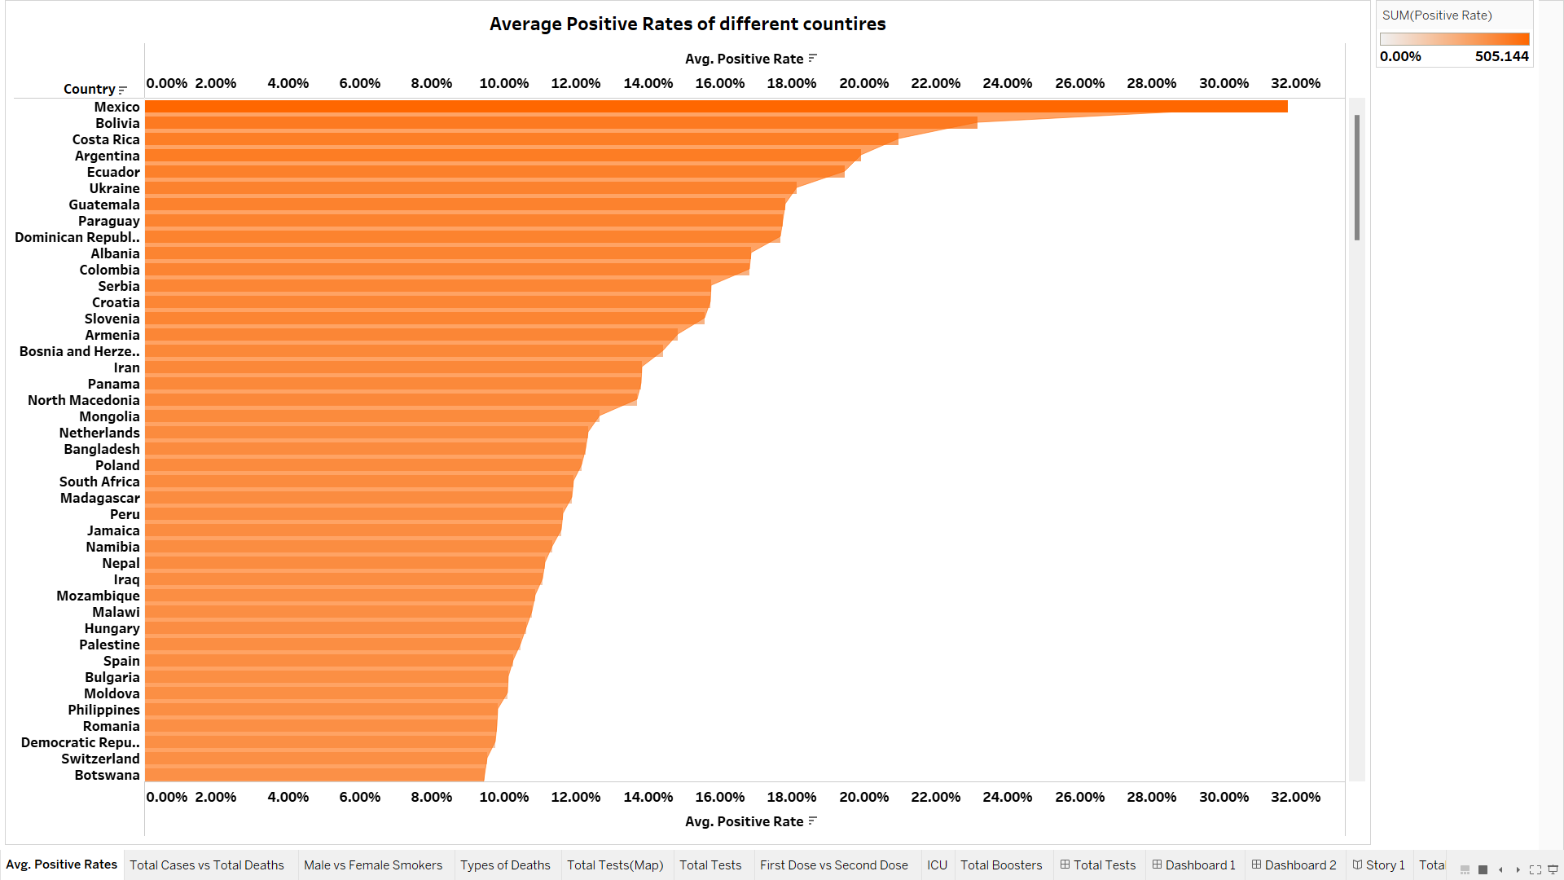
Bar chart
Here, Mexico has highest average covid positive rate with 31.77%

Slide 18
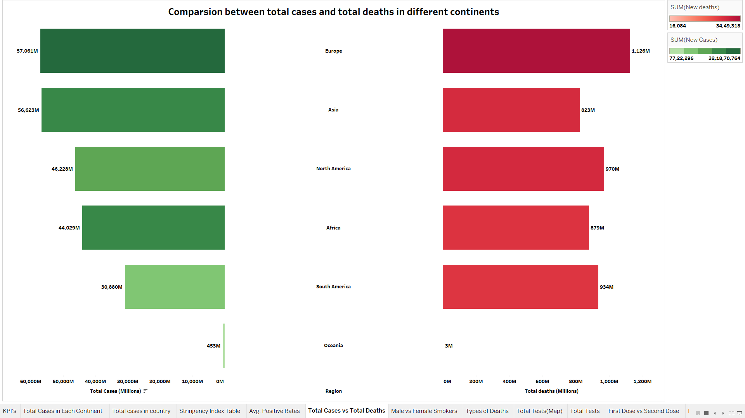
Butterfly Chart
Difference in values of total cases and total deaths. You can see all the number of deaths are less than number of cases . We can also say that means total cases might also have people who are false positive or have very mild effects of covid.

Slide 19
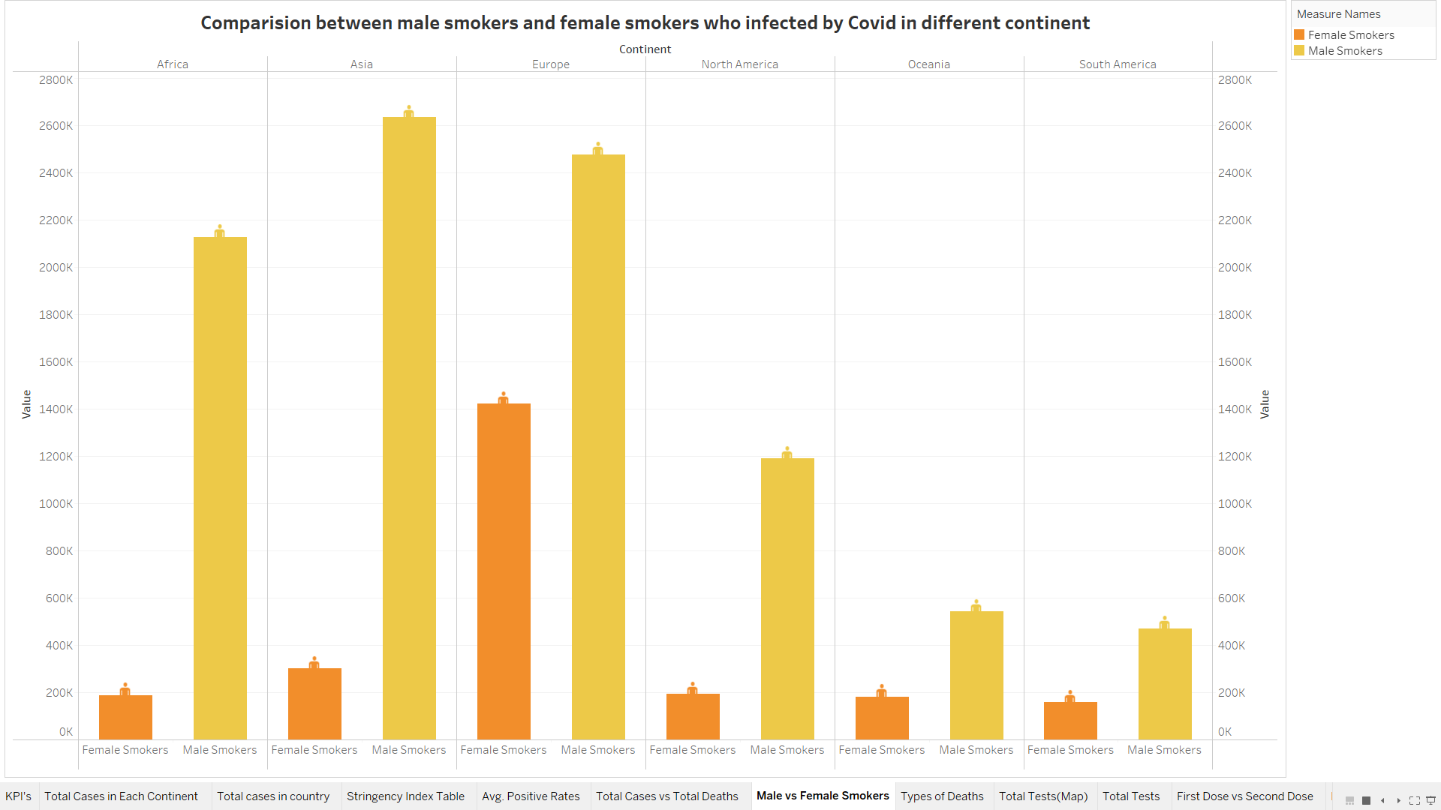
Double Bar Chart
We are seeing the number of female smoker vs male smokers . According to this chart, Asia and Europe has highest no. of smokers. Also, Male smokers are more effected then Females.

Slide 20
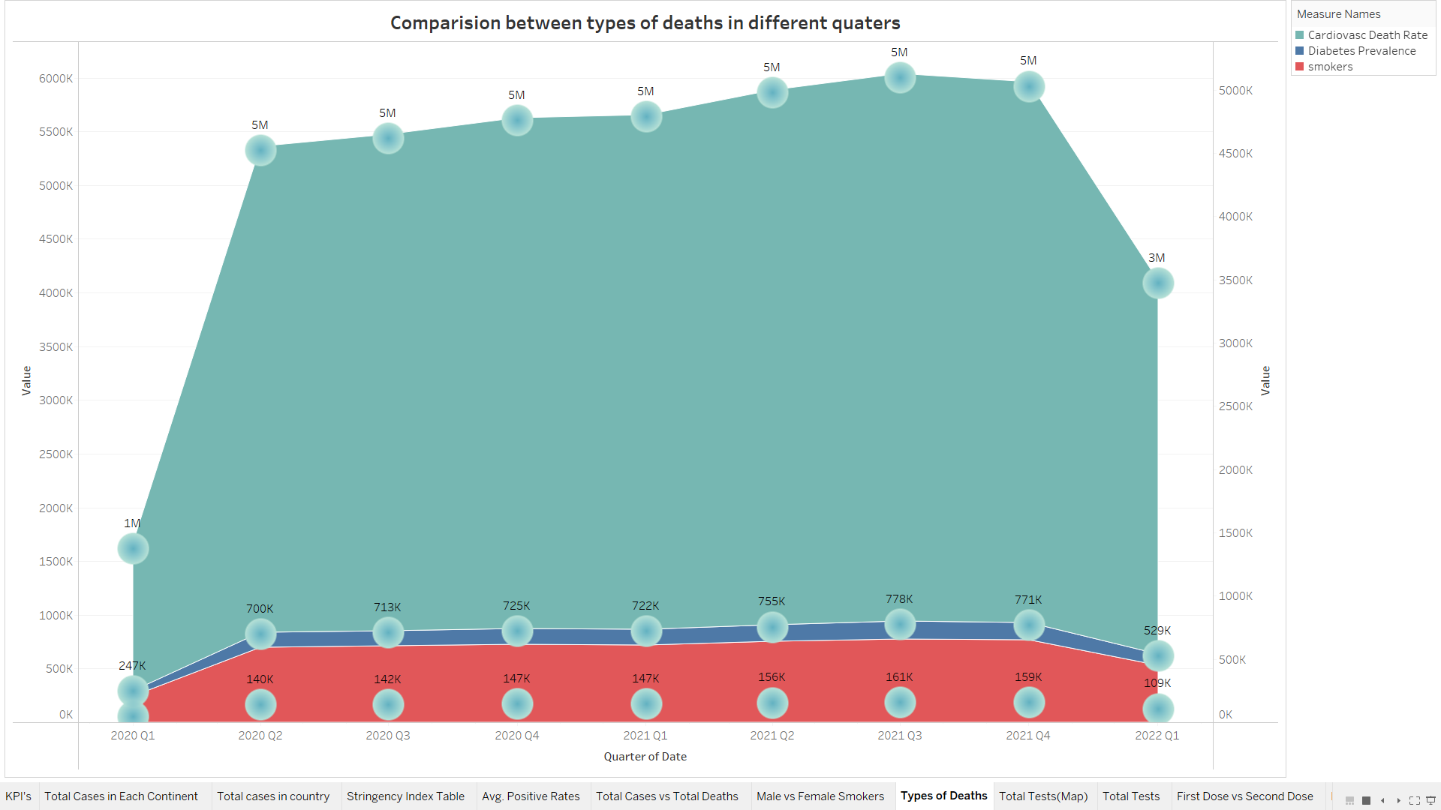
Area Chart
You can see 3 types of lifestyle issues causing more deaths . There are research done on all the three disease which shows it.

Slide 21
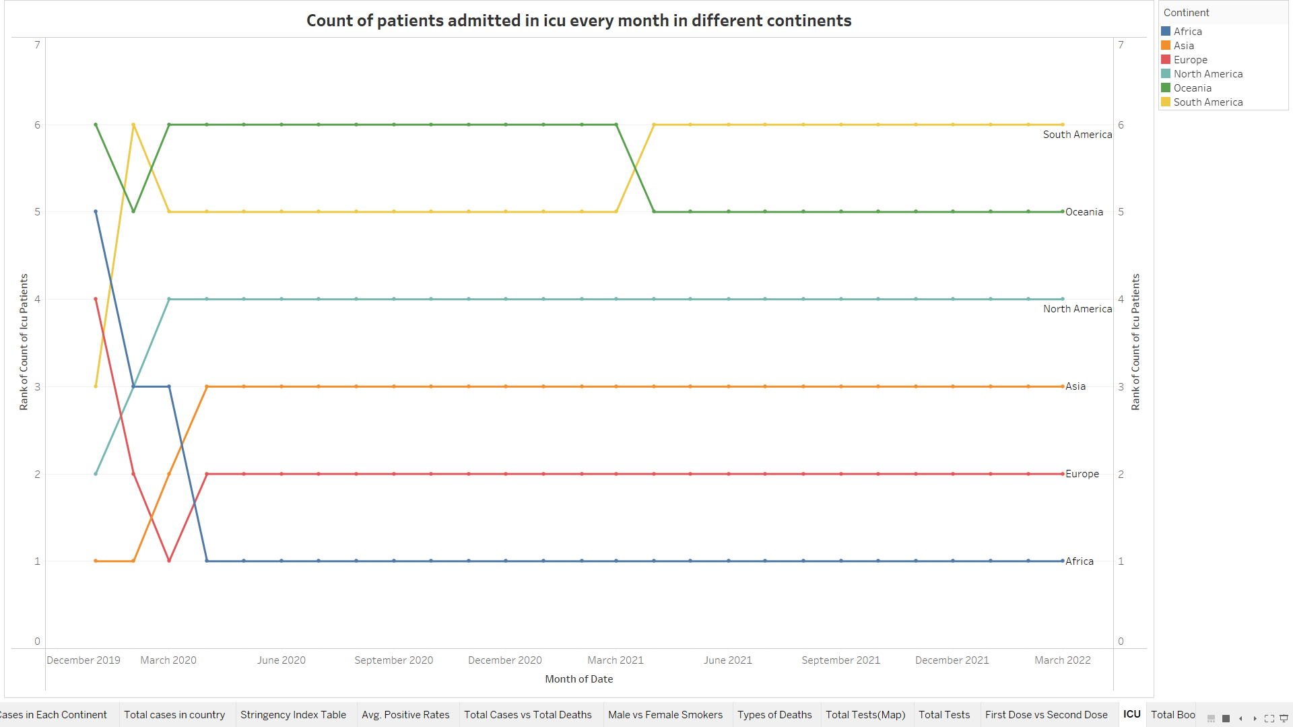
Rank Chart
This is rank chart which shows us the ranks of continents according to patients admitted in the ICU every month .

Slide 22
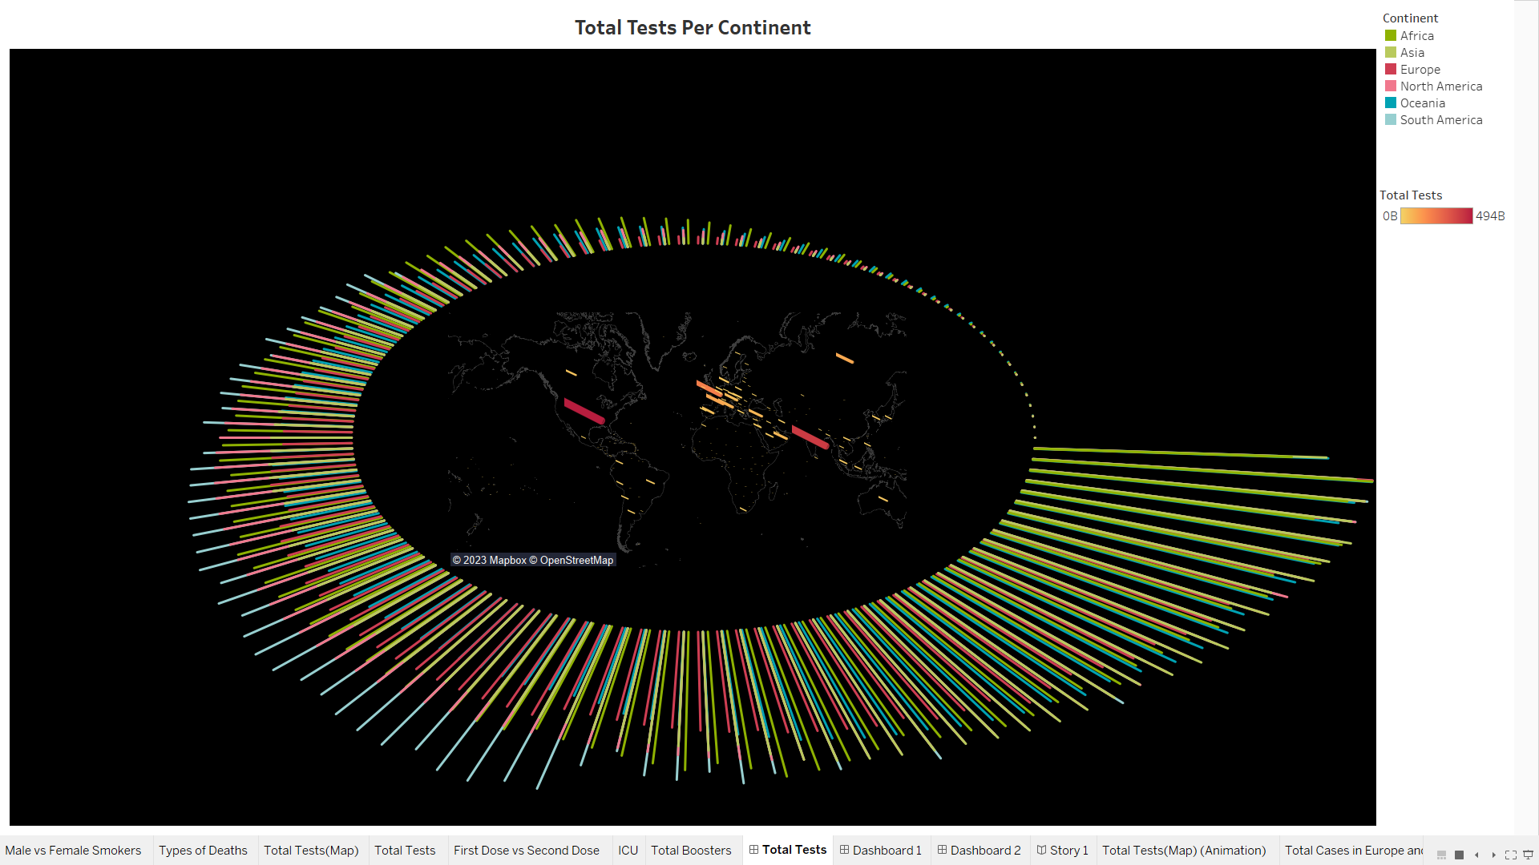
Tests
Please Update

Slide 23
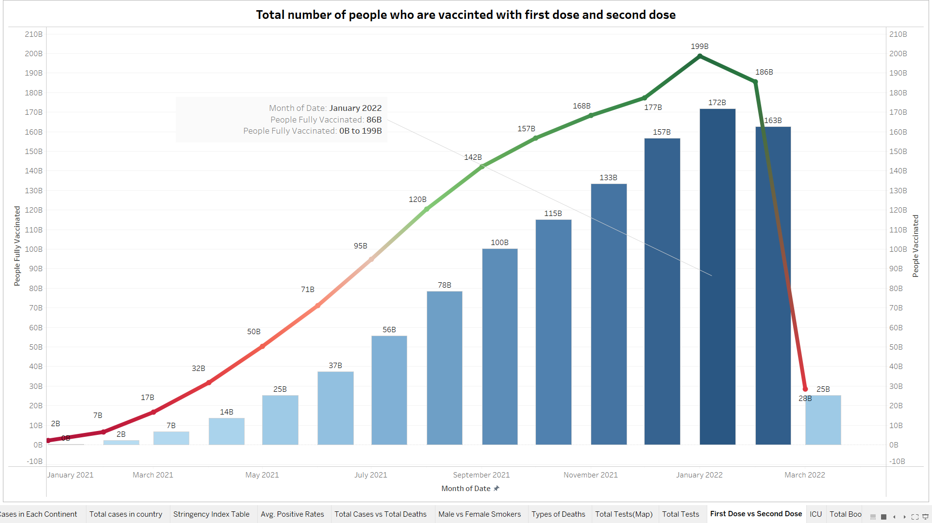
Bar & Line Chart
There are a greater number of people who are vaccinated with 1st dose and less of people who are vaccinated with both does throughout .

Slide 24
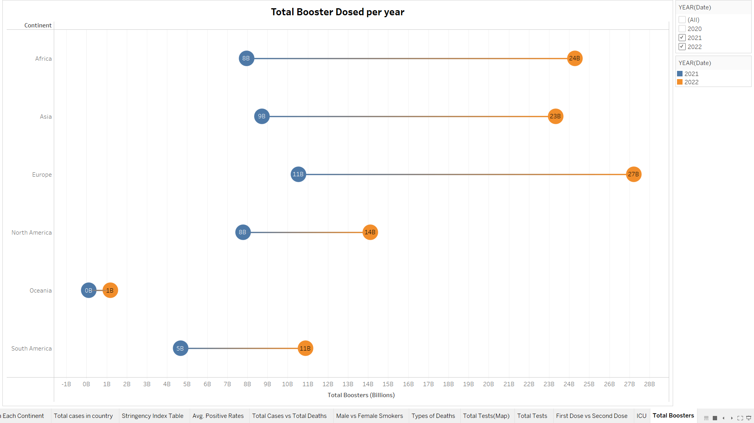
Dumbell Chart
This chart shows the difference between two years of data of people who have taken booster dose .

Slide 25
Impact
Some people lost their jobs.
Lockdown , handling everything being at home was not easy for everyone.
Educational impact : kids who just started their schooling had to attend their 1st day of school online.
For parents handling kids at home and working for office at the same time was also difficult.

Slide 26
SWOT Analysis
STRENGTHS
Outgoing People learnt to spend time with their loved ones
WEAKNESSES
People who were away from family felt depressed and lonely
S
W
Work from where you are was brought up
OPPORTUNITIES
Covid is not ended yet It may be coming in different variant
THREATS
O
T

Slide 27
Recommendations
Today the cases have come to very less compare to the pandemic, but we cannot say that it is the end of covid as there is new variants coming up.
Taking precautions are major step to prevent covid.
Wearing mask in crowded place, washing hand before eating food are some basic precautions that can be followed.

Slide 28
Summary
We can see heart decease causing more deaths compare to other health issues.
Smoking making lungs week causing covid infection to affect more easily.
You can see total number of cases and total number of deaths have a huge difference which means that there are a huge number of people who got cured .

Slide 29
References
Background - https://www.hopkinsmedicine.org/health/conditions-and-diseases/coronavirus
Dataset - https://www.kaggle.com/datasets/georgesaavedra/covid19-dataset
Smoking - https://www.nhlbi.nih.gov/news/2022/smoking-associated-increased-risk-severe-covid-19-outcomes

Slide 30
References
Heart disease - https://www.heart.org/en/news/2023/01/27/researchers-take-a-closer-look-at-what-covid-19-does-to-the-heart
Stringency Index - https://ourworldindata.org/covid-stringency-index

Slide 31
THANK YOU

